Slide 1


Volume 101
Friday, October 25,2024
News Fusion
News Classification, Summarization
& Translation
Developed By :
IT129-SHAH KHUSHI BIRENKUMAR
IT128-SHAH HETVI JATILKUMAR
Supervised By:
Prof. Sunil K.Vithlani

Slide 2

News Fusion
Volume 101
Friday, October 25,2024
Agenda
Introduction
Origin Of the Idea
Tech Stack & Dataset
Methodology
Models Used
Analysis and Results
Benefits
Future Directions
Pictorial Demo

Slide 3

News Fusion
Volume 101
Friday, October 25,2024
Introduction
In an era of rapidly expanding digital news, efficient organization and retrieval of information are vital. Automatic news translation addresses the challenges of language barriers by enabling users to access news in their preferred language.
Additionally, the project focuses on classifying news articles into specific categories, allowing users to quickly find content that interests them. To cater to users' busy lifestyles, it also provides concise summaries of articles, ensuring they stay informed without reading lengthy texts.
page 01

Slide 4

News Fusion
Volume 101
Friday, October 25,2024
Origin of the Idea
Addressing Language Barriers:
Users face challenges accessing news in different languages. This
project breaks down those barriers by offering automatic
translations.
Category-Specific News Focus:
Many users prefer reading news from specific categories rather
than browsing through irrelevant content. This project provides a
category selection feature.
Quick News Summaries:
Users with busy schedules often prefer brief news updates over
lengthy articles. This project offers concise news summaries to
meet that need.
page 02

Slide 5




News Fusion
Volume 101
Friday, October 25,2024
Tech Stack
Python
Flask Server
React JS
Utilized for machine learning and backend development, enabling efficient data processing and model training.
A lightweight web framework used to create the server-side application, handling requests and responses.
Employed for frontend development to build a dynamic and interactive user interface, enhancing user experience.
page 03

Slide 6

News Fusion
Volume 101
Friday, October 25,2024
Dataset
The dataset used for this project consists of the following columns:
Link: The URL of the news article, allowing users to access the full content directly.
Headline: The title of the news article, providing a brief indication of the content and its main topic.
Category: The classification of the news article, such as Business, Politics, Sports, etc., helping users filter news based on their interests.
Short Description: A brief summary of the news article, offering key information and context without requiring users to read the entire piece.
Authors: The names of the authors who contributed to the news article, adding credibility and allowing users to explore other works by the same authors.
Date: The publication date of the news article, enabling users to find the most recent updates or historical news articles.
page 04

Slide 7
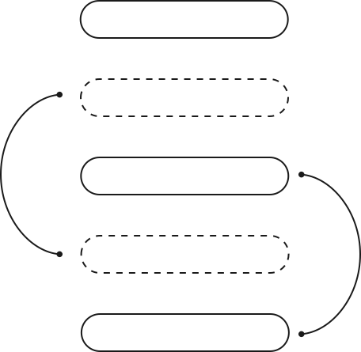
News Fusion
Volume 101
Friday, October 25,2024
Methodology
Dataset Preparation: A labeled dataset is prepared for training the classification model.
Model Training: The models are trained on the prepared dataset, and the trained models are saved using Pickle.
News Fetching: News articles are fetched using the NewsEverything API.
Category Prediction: The fetched news articles are classified into categories using the trained model.
News Summarization: An additional module is implemented to summarize the classified news articles.
Translation: The summarized news articles can be translated into the user's preferred language.
Step 1
Step 2
Step 3
Step 4
Step 5
page 05

Slide 8

News Fusion
Volume 101
Friday, October 25,2024
Models Used
1. Logistic Regression: A statistical model predicting the probability of a class; used for classifying news articles due to its simplicity and interpretability.
2. Multinomial Naive Bayes: A probabilistic classifier assuming feature independence; employed for efficiently categorizing news articles based on word frequencies.
3. Support Vector Machines (SVM): A supervised model finding the optimal hyperplane for classification; used to enhance accuracy in classifying high-dimensional news data.
4. Random Forest: An ensemble method combining multiple decision trees for classification; integrated to improve robustness and accuracy in news categorization.
page 06

Slide 9

News Fusion
Volume 101
Friday, October 25,2024
Analysis
Analysis 1: Logistic Regression
Accuracy: 73.11%
Key Findings:
Demonstrated effective classification with a balanced performance across various categories.
Ability to generalize well on the dataset, providing reliable predictions.
Analysis 2: Support Vector Machine (SVM)
Accuracy: 71.24%
Key Findings:
Maintained stable performance across different types of news articles.
Provided good margin separation, though occasionally struggled with specific content nuances.
page 07

Slide 10
News Fusion
Volume 101
Friday, October 25,2024
Analysis
Analysis 3: Multinomial Naive Bayes
Accuracy: 70.56%
Key Findings:
Showed strong results in handling large text data, leveraging word frequency for classification.
While effective overall, it faced challenges with highly diverse news content.
Analysis 4: Random Forest
Accuracy: 56.76%
Key Findings:
Encountered limitations in achieving high accuracy, indicating room for improvement.
The model exhibited variability in performance, suggesting the need for parameter tuning.
page 08

Slide 11
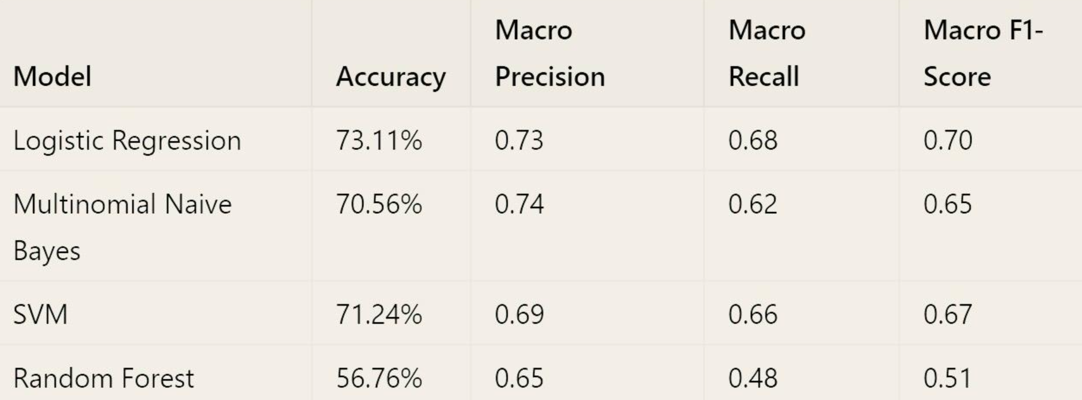
News Fusion
Volume 101
Friday, October 25,2024
Results
page 09

Slide 12

News Fusion
Volume 101
Friday, October 25,2024
Benefits
Enhanced Accessibility: Breaks down language barriers, allowing users to access news in their preferred language.
Targeted Content Delivery: Users can focus on specific news categories that interest them, improving their reading experience.
Time Efficiency: Provides concise summaries, enabling users to quickly grasp the essential points of news articles.
User Engagement: Personalized news recommendations foster greater user interaction and satisfaction.
Adaptability: The system can evolve based on user feedback and emerging technologies, ensuring it remains relevant and effective.
page 10

Slide 13

News Fusion
Volume 101
Friday, October 25,2024
Future Directions
Predictive Analytics for Personalization: Tailor news recommendations based on user preferences.
Advanced Categorization: Utilize deep learning for improved categorization accuracy.
Feedback Mechanisms: Implement user feedback systems for continuous model improvement.
Emerging Technologies: Integrate AI tools like chatbots for enhanced news delivery.
Multi-Modal Delivery: Offer news in text, audio, and video formats to enhance engagement.
page 11

Slide 14
News Fusion
Volume 101
Friday, October 25,2024
Snapshot of Features
page 12

Slide 15


News Fusion
Volume 101
Friday, October 25,2024
THANK YOU FOR YOUR ATTENTION!
Members
Khushi
Hetvi

